Slide 1
.NET Core
.NET Core is a new version of .NET Framework.
.NET Core is a cross-platform, open-source framework developed by Microsoft for building modern, high-performance applications.
It’s the next generation of the traditional .NET Framework, designed to work on:
✅ Windows ✅ macOS ✅ Linux
.NET Core Framework can be used to build different types of applications such as mobile, desktop, web, cloud, IoT, machine learning, microservices, game, etc.

Slide 2
Why .NET Core?
Feature | Description
Cross-Platform | Runs on Windows, Linux, and macOS.
High Performance | Optimized runtime for fast execution and scalable apps.
Modular & Lightweight | You install only the required packages via NuGet.
Open Source | Managed by Microsoft & the community on GitHub.
Unified Platform | Supports Web, Desktop, Cloud, Mobile, Microservices, IoT, and more.
Side-by-Side Versioning | Multiple .NET versions can run on the same system.

Slide 3
Main Features / Characteristics of .NET Core
No. | Feature | Explanation
1 | Cross-Platform | .NET Core runs on Windows, Linux, and macOS — meaning you can develop and host your applications on any OS.
2 | Open Source | .NET Core is open-sourced under the MIT license and maintained by Microsoft and the developer community on GitHub.
3 | High Performance & Scalability | It’s optimized for performance — ASP.NET Core apps are among the fastest web frameworks today. Ideal for high-traffic or enterprise systems.
4 | Modular & Lightweight | Uses NuGet packages, so you include only what you need — reducing app size and improving startup time.
5 | Unified Framework | Supports multiple types of applications: Web, Cloud, Desktop, Mobile, IoT, AI, and Microservices — all using one platform.

Slide 4
Main Features / Characteristics of .NET Core
No. | Feature | Explanation
6 | Command-Line Interface (CLI) | Provides a powerful CLI tool (dotnet) for creating, building, running, testing, and publishing projects from the terminal.
7 | Side-by-Side Versioning | Different .NET Core versions can run on the same machine without conflict — perfect for microservice architectures.
8 | Dependency Injection (Built-In) | Has native support for Dependency Injection (DI), which improves code maintainability and testability.
9 | Unified Development Model | Same programming languages (C#, F#, VB.NET) and same libraries can be used across all application types.
10 | Microservices Friendly | Designed to work with Docker, Kubernetes, and other cloud-native tools — great for distributed systems.
11 | Cloud Integration | Deep integration with Microsoft Azure and other cloud platforms for hosting, CI/CD, and monitoring.

Slide 5
Main Features / Characteristics of .NET Core
No. | Feature | Explanation
12 | Asynchronous Programming Support | Built-in support for async/await, improving scalability in I/O-bound applications like APIs.
13 | Improved Security | Offers features like HTTPS by default, Data Protection APIs, Authentication & Authorization middleware.
14 | Cross-Language Interoperability | You can use C#, F#, or VB.NET together in the same solution if needed.
15 | Automatic Garbage Collection | Managed memory system handles cleanup automatically, improving performance and reliability.
16 | Unified Runtime & SDK | One SDK supports all platforms and project types — simplifying development and deployment.
17 | Entity Framework Core (EF Core) | Modern, lightweight ORM (Object Relational Mapper) for seamless database operations.

Slide 6
Main Features / Characteristics of .NET Core
No. | Feature | Explanation
18 | Hot Reload | Allows developers to make code changes and see updates instantly without restarting the app (introduced in .NET 6).
19 | Cross-Platform Hosting | You can host .NET Core apps on IIS, Nginx, Apache, Docker, or self-host them..
20 | Blazor & MAUI Support | Enables web UI development with C# instead of JavaScript (Blazor), and cross-platform mobile apps using .NET MAUI.

Slide 7
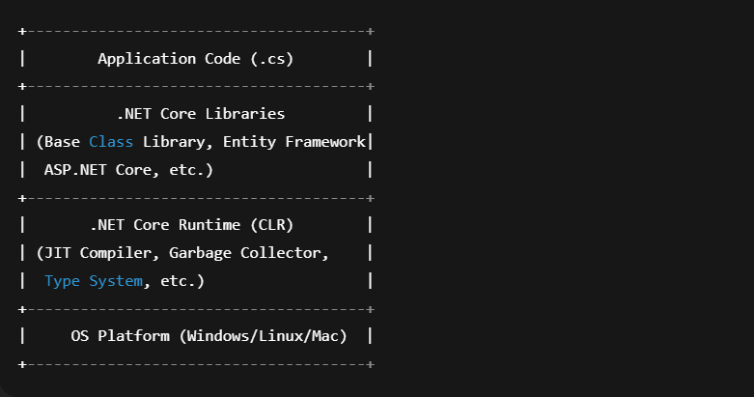
Architecture Overview

Slide 8
Types of Applications You Can Build
Type | Framework/Tool | Description
Web Apps & APIs | ASP.NET Core | Build MVC, Razor Pages, REST APIs
Desktop Apps | WPF / WinForms (.NET 6+) | Build GUI-based applications
Microservices | ASP.NET Core + Docker/Kubernetes | Lightweight, deployable services
Cloud Apps | Azure + .NET | Deploy apps to the cloud
Mobile Apps | .NET MAUI / Xamarin | Cross-platform mobile development
Console Apps | .NET Core Console | Lightweight command-line tools

Slide 9
Key Components
CLR (Common Language Runtime)
Executes code and manages memory, threads, and exceptions.
BCL (Base Class Library)
Provides common functions (I/O, Collections, LINQ, etc.).
ASP.NET Core
Framework for building web applications and APIs.
Entity Framework Core (EF Core)
ORM (Object Relational Mapper) for database operations.
CLI (Command-Line Interface)
For creating, building, running, and publishing apps.

Slide 10
Common CLI Commands
Command | Description
dotnet new webapi -n MyApi | Create a new Web API project
dotnet build | Build the project
dotnet run | Run the application
dotnet publish | Prepare for deployment
dotnet test | Run unit tests

Slide 11
.NET Versions Timeline
Version | Year | Notes
.NET Core 1.0 | 2016 | Initial cross-platform release
.NET Core 2.0 | 2017 | Major improvements
.NET Core 3.1 | 2019 | LTS version
.NET 5 | 2020 | Unified all .NET platforms
.NET 6 (LTS) | 2021 | Long Term Support
.NET 7 | 2022 | Performance boost
.NET 8 (LTS) | 2023 | Current stable LTS version
.NET 9 | 2024–25 | Next major release

Slide 12
Differences Between .NET Core and .NET Framework
Feature | .NET Framework | .NET Core (now .NET 5+)
Introduction Year | 2002 | 2016
Platform Support | Windows only | Cross-platform (Windows, Linux, macOS)
Open Source | Partially open source | Fully open source (on GitHub)
Application Types | Web (ASP.NET), Desktop (WPF, WinForms), Console | Web, Desktop, Cloud, IoT, Mobile, Microservices, Console
Performance | Slower and heavier | Lightweight and high-performance
Deployment | Installed system-wide | Self-contained or framework-dependent deployment

Slide 13
Differences Between .NET Core and .NET Framework
Feature | .NET Framework | .NET Core (now .NET 5+)
Architecture | Monolithic | Modular and lightweight (via NuGet packages)
CLI (Command Line Interface) | Limited (mainly Visual Studio GUI) | Rich CLI support (dotnet command)
Dependency Injection (DI) | Third-party libraries needed | Built-in Dependency Injection support
Versioning | One version per machine | Side-by-side versioning supported
Microservices Support | Difficult to implement | Designed for microservices architecture
Container Support (Docker) | Not suitable | Fully supported

Slide 14
Differences Between .NET Core and .NET Framework
Feature | .NET Framework | .NET Core (now .NET 5+)
Hosting | IIS only | Can run on Kestrel, IIS, Nginx, Apache, Docker, etc.
Development IDEs | Mainly Visual Studio (Windows) | Visual Studio, VS Code, JetBrains Rider (cross-platform)
Cross-Language Support | C#, VB.NET, F# | C#, VB.NET, F#, more unified SDK
Mobile Development | Not supported | Supported through .NET MAUI / Xamarin
Updates & Future | No longer evolving (maintenance only) | Actively developed (.NET 8 is current LTS)

